Slide 1
FALL & HOLIDAY
2018 CAMPAIGN

Slide 2
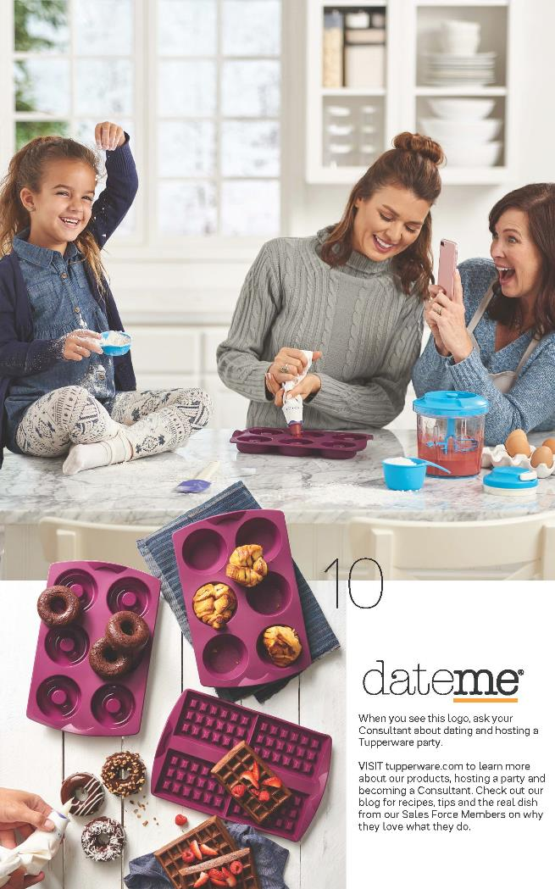
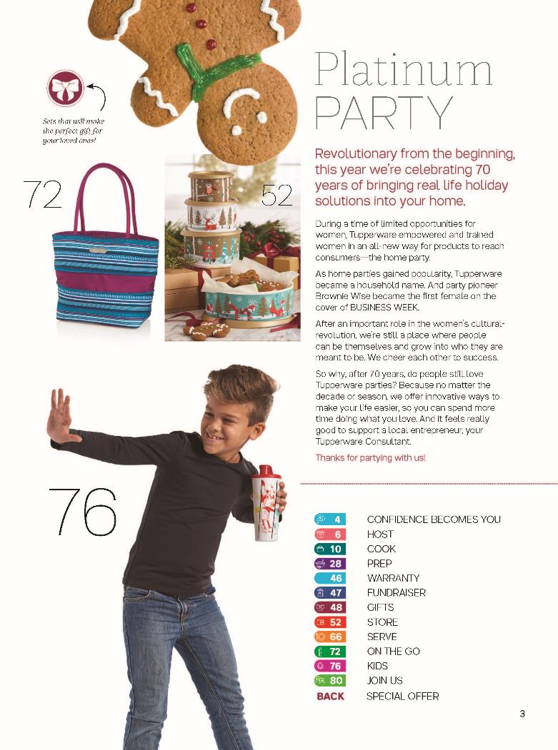
SOLUTIONS:
Cooking & Baking
Gift Giving
Saving Time

Slide 3
SUPPORT AVAILABLE FOR SALES FORCE ON MY.TUPPERWARE.CA
Catalog Consumer Video – Long Version
Catalog Consumer Video – Short Version
Date Me Recipe Cards
Date Me memes
Product support memes
Silicone Baking Forms Consumer Short Video
More to come shared on our social channels all season long!
CATALOG SALES SUPPORT
Notes:
Baking Sweet
Baking Savory
Microwave Sweet
Microwave Savory
Refrigerator
Freezer

Slide 4
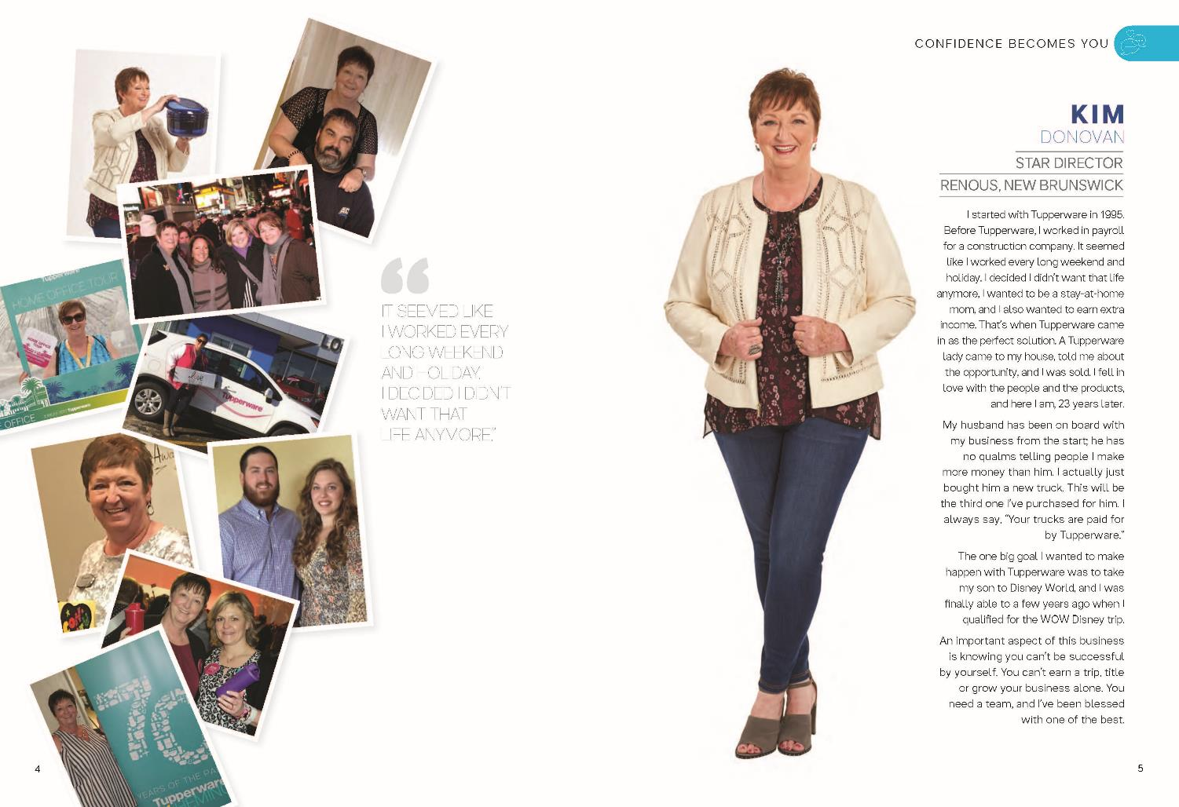
SPOTLIGHT ON

Slide 5
DATE ME, HOST EXCLUSIVE, FUNDRAISING, AND PWP

Slide 6
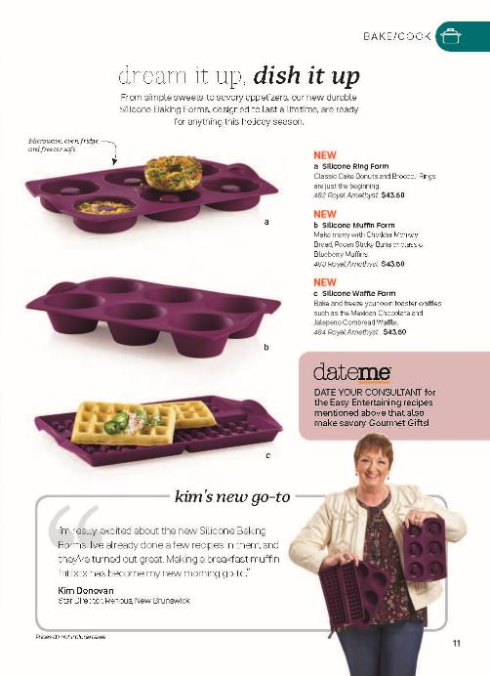
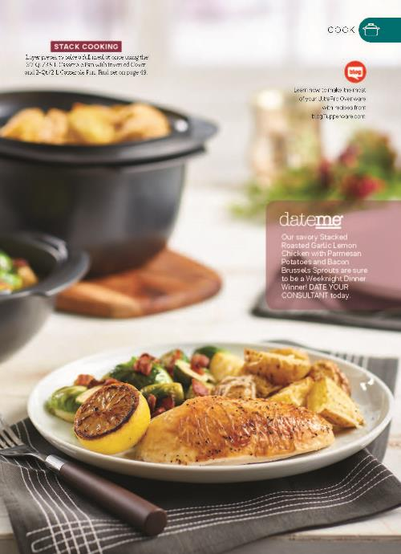
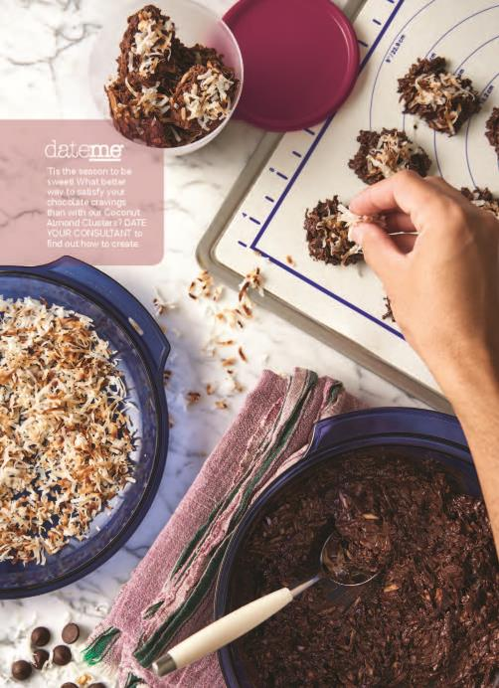
DATE ME CALLOUTS
Focus on moments with recipe inspiration - a great lead-in for datings. Dating Tools for You: Recipe Cards and Memes (find them throughout this presentation).

Slide 7
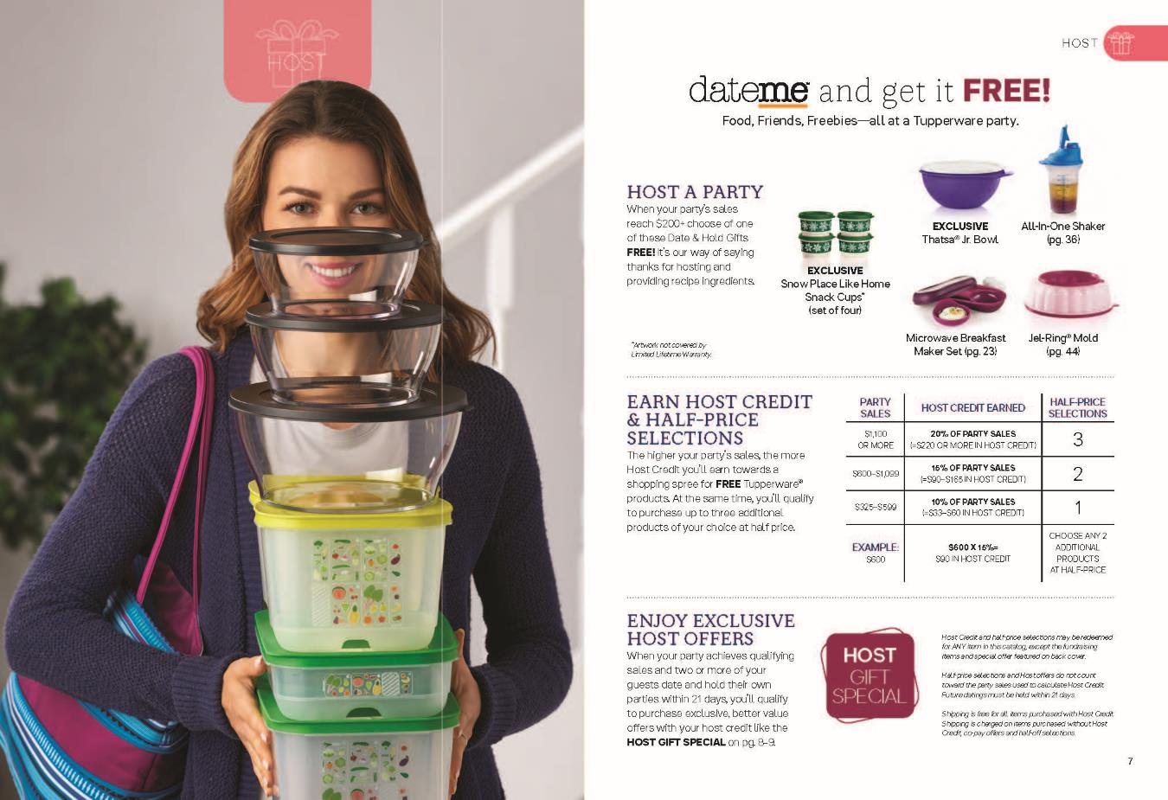
EXCLUSIVE DATE ME
Two date me exclusives to perfectly inspire the season of gift giving and baking/cooking.

Slide 8
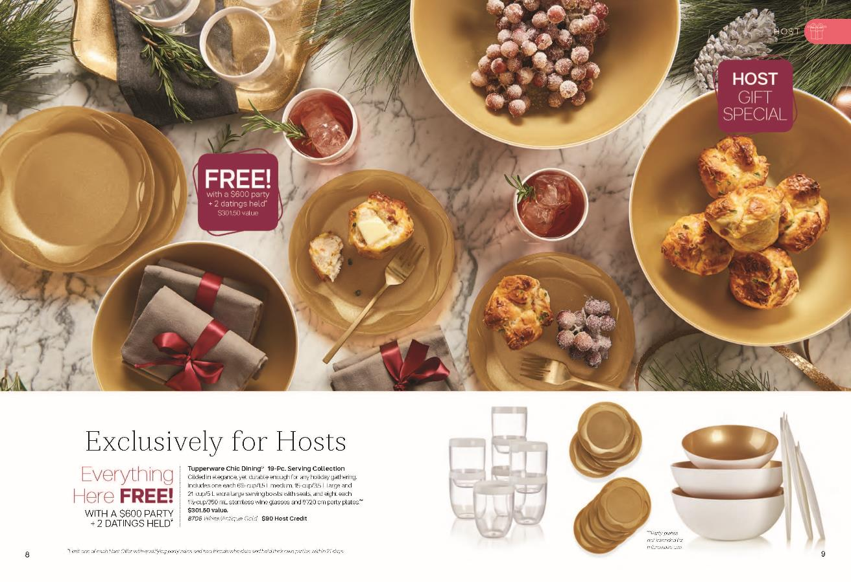
EXCLUSIVE FOR HOSTS
Holiday serving at its best – elegant and durable, the best of both worlds.
Confidential – Do Not Share

Slide 9
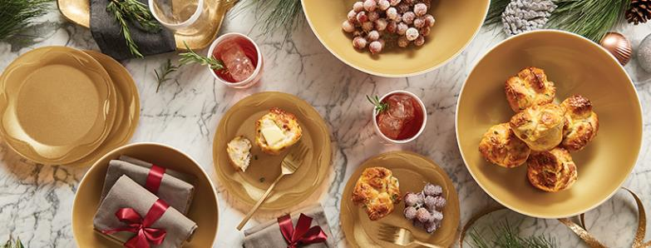
HOST SOCIAL MEDIA COVERS AND MEMES

Slide 10
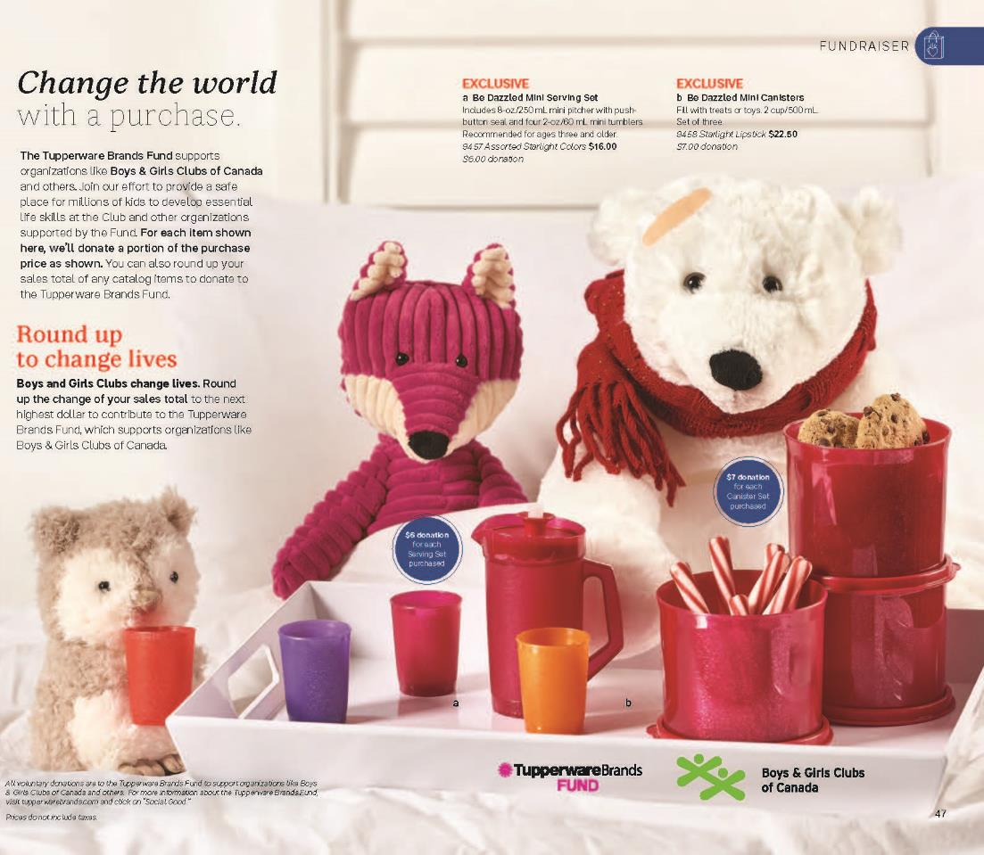
FUNDRAISER
The Holidays are a time of giving back and changing lives, with these DAZZLING Children’s Gifts.

Slide 11
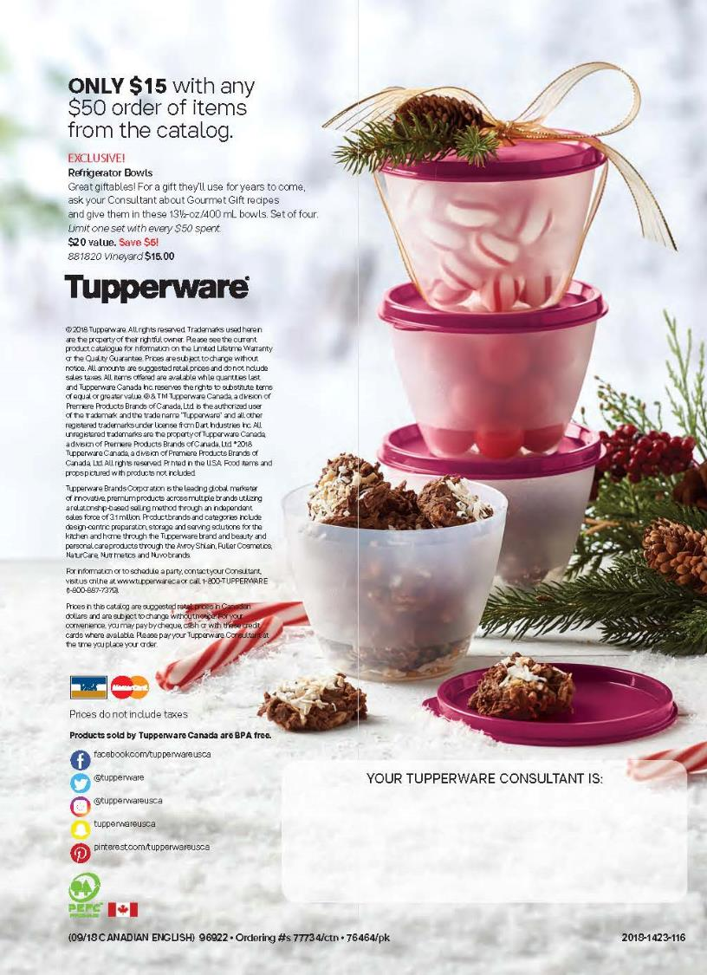
PURCHASE WITH PURCHASE
Increase your party sales by offering these Refrigerator Bowls (set of 4, exclusively in Vineyard).
Your customers can fill with home baked sweets and give as gifts to teachers, babysitters or mail carriers. The giving is endless!

Slide 12
PURCHASE WITH PURCHASE MEME

Slide 13
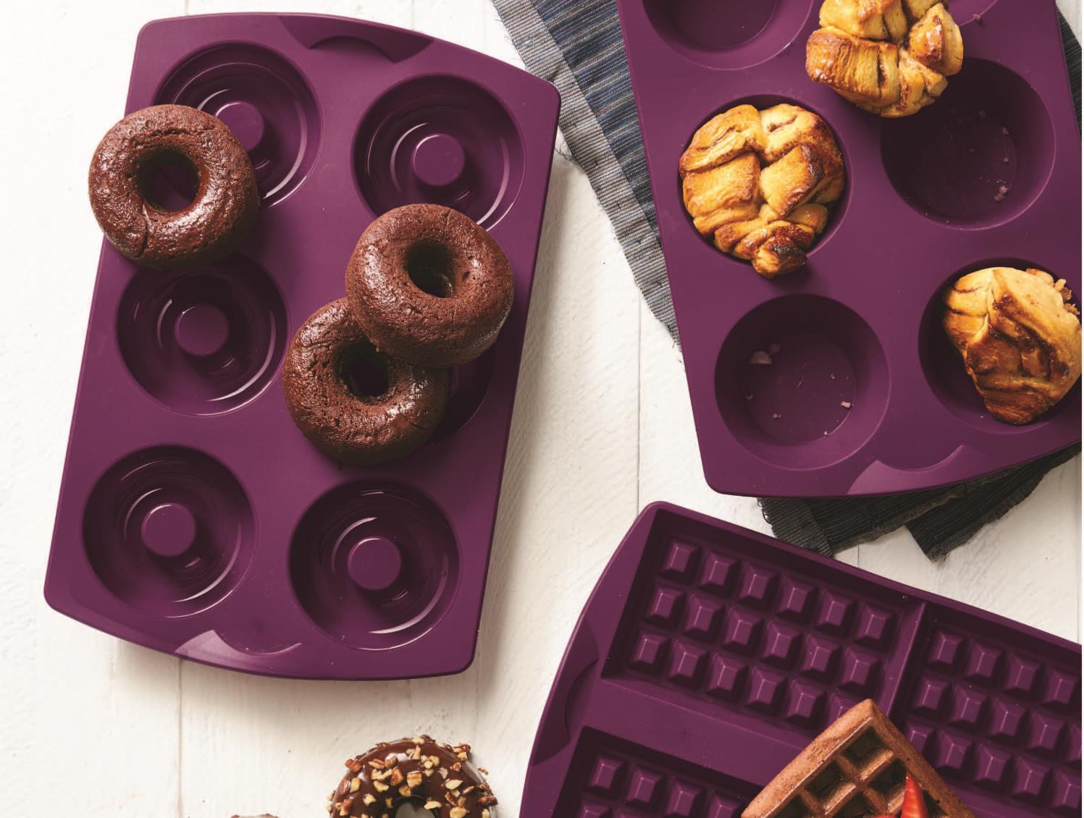
NEW PRODUCTS AND
BRING BACKS

Slide 14
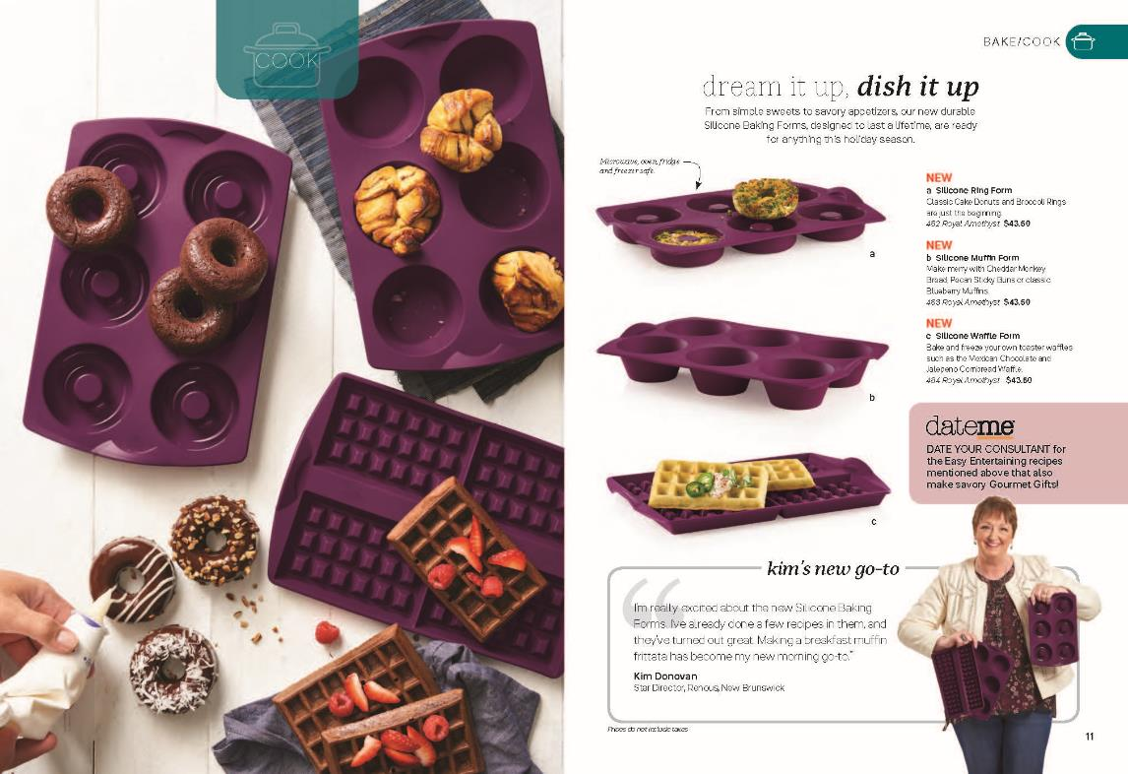
SILICONE BAKING FORMS
Cook or bake your way through the holidays and beyond with our durable, non-stick, easy cleaning Silicone Baking Forms. From freezer to fridge and microwave to oven, the savory appetizers and sweet desserts are endless. Go to My.Tupperware to learn about the Silicone Baking Forms and find some new recipes for your party.
Featuring a testimonial from our Sales Force!

Slide 15
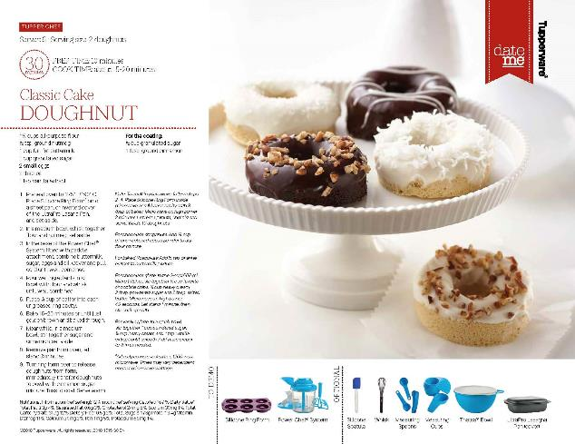
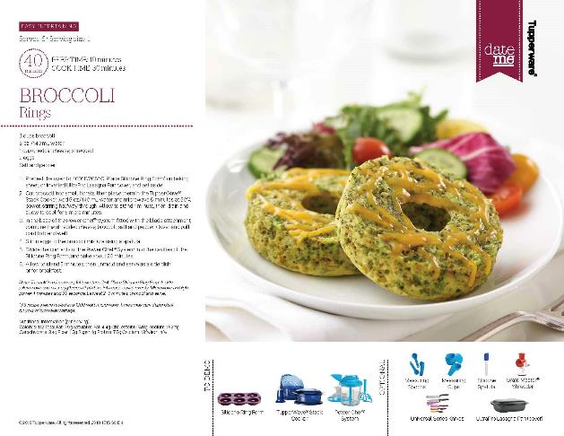
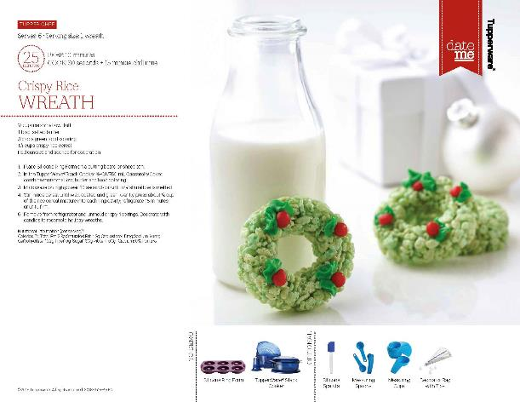
SILICONE RING FORM DATE ME RECIPE CARDS

Slide 16
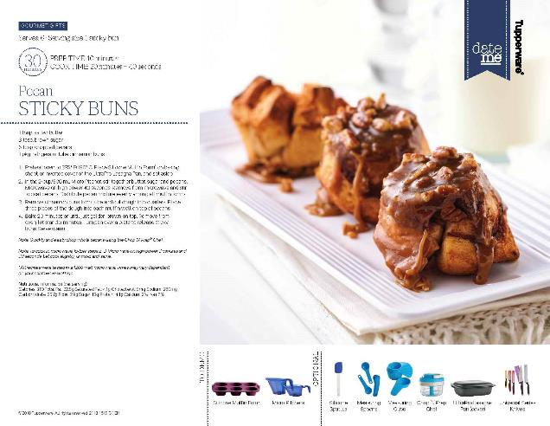
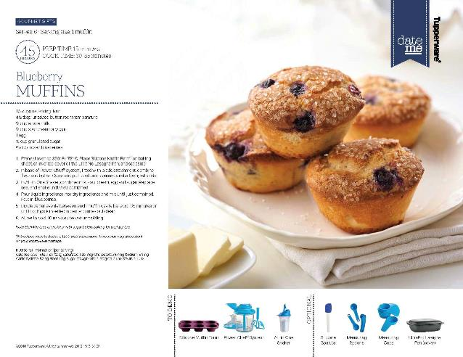
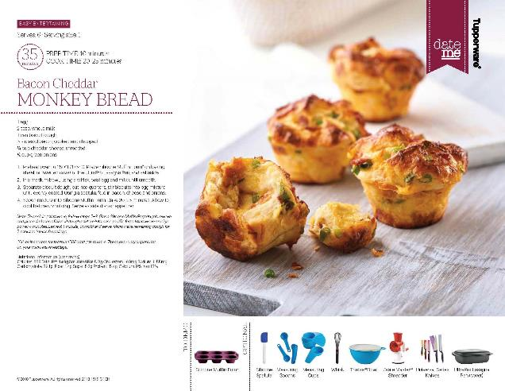
SILICONE MUFFIN FORM DATE ME RECIPE CARDS

Slide 17
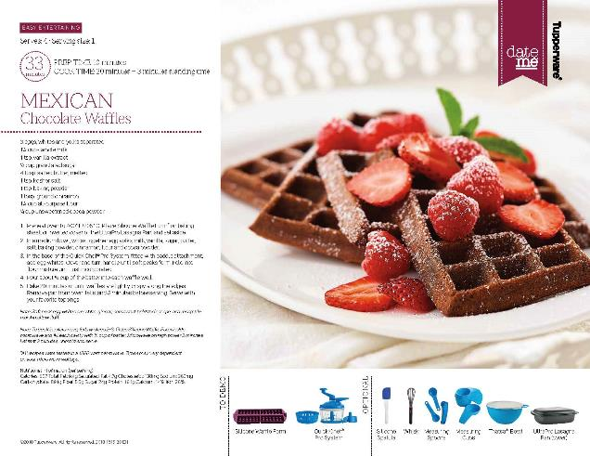
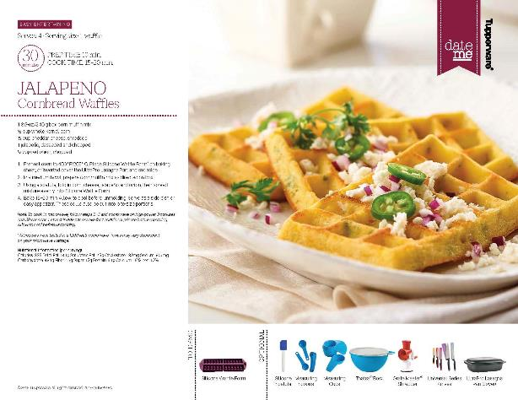
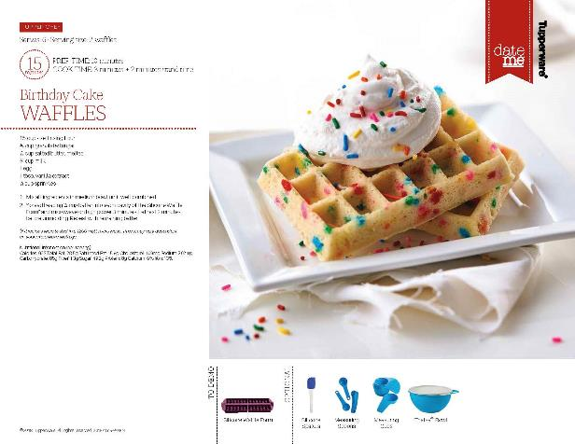
SILICONE WAFFLE FORM DATE ME RECIPE CARDS

Slide 18
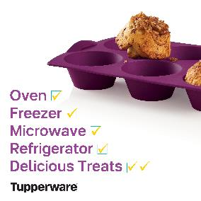
SILICONE BAKING FORMS MEMES AND COVER

Slide 19
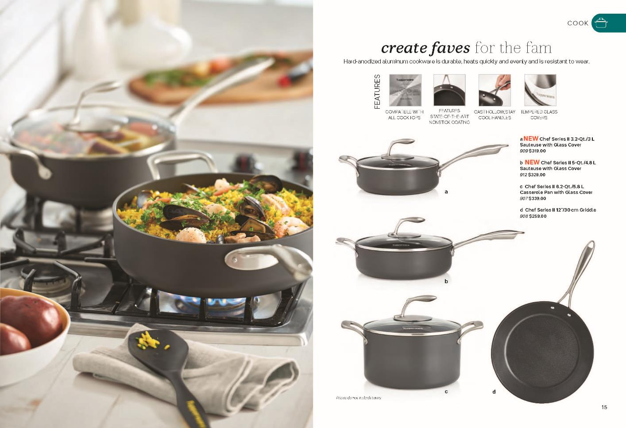
CHEF SERIES II SAUTEUSES W/ GLASS COVERS

Slide 20
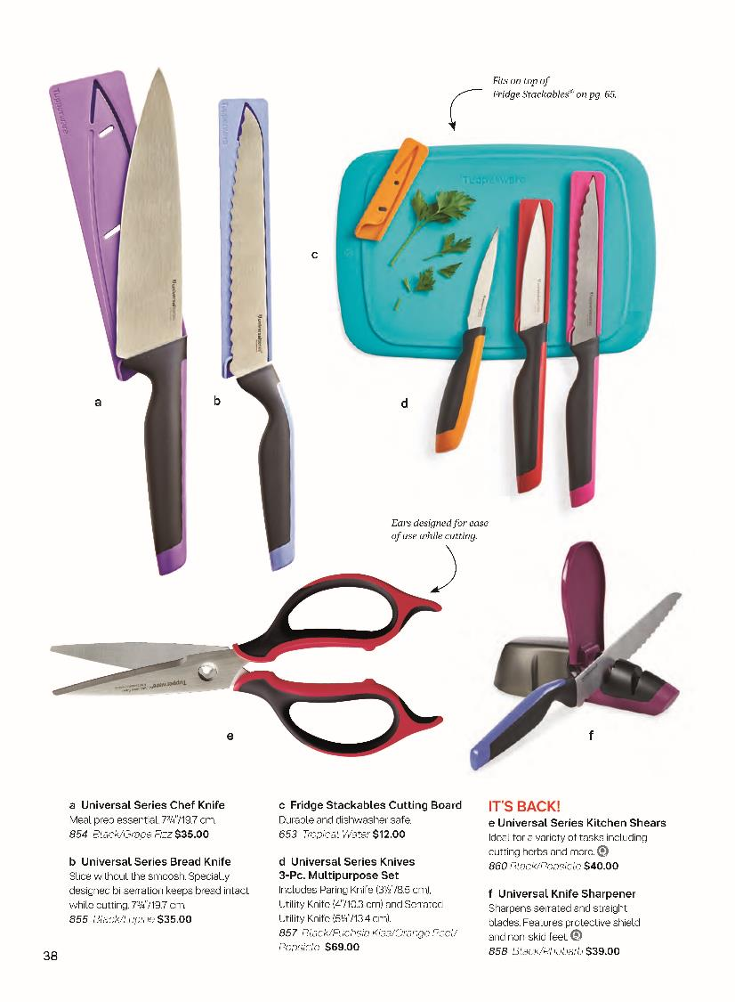
UNIVERSAL SERIES KITCHEN SHEARS
Your “DO IT ALL” Universal Series Kitchen Shears. Great for cooking, baking, or even gift wrapping or unwrapping this holiday season.
Do you know why the handles have ears? Check out the catalog for unique product features.

Slide 21
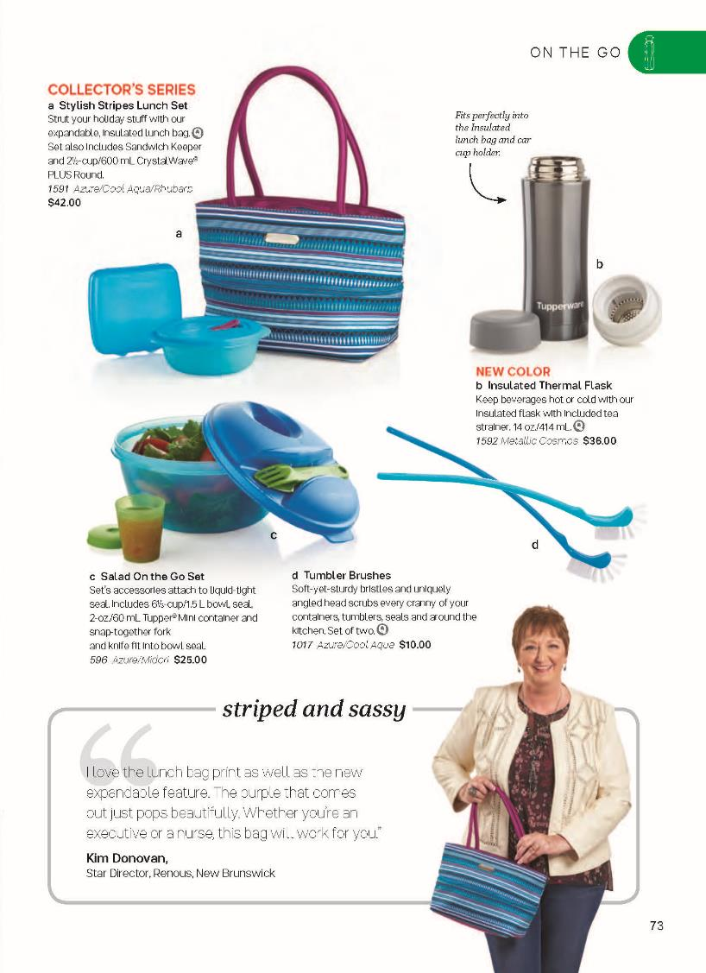
INSULATED THERMAL FLASK
Keep your beverages hot or cold for hours. The perfect companion to ON THE GO, anytime of the year.
Do you know it fits perfectly into the Stylish Stripes Lunch Set and your car cup holder? Check out the catalog for unique product features.

Slide 22
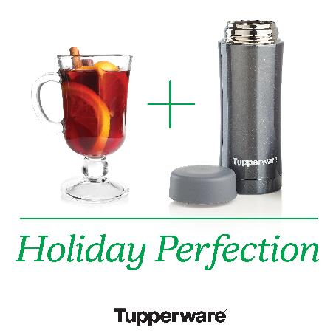
INSULATED THERMAL FLASK MEMES

Slide 23
COLLECTOR’S SERIES,
GIFTS, SEASONAL,
ANDCOLOR CHANGES

Slide 24
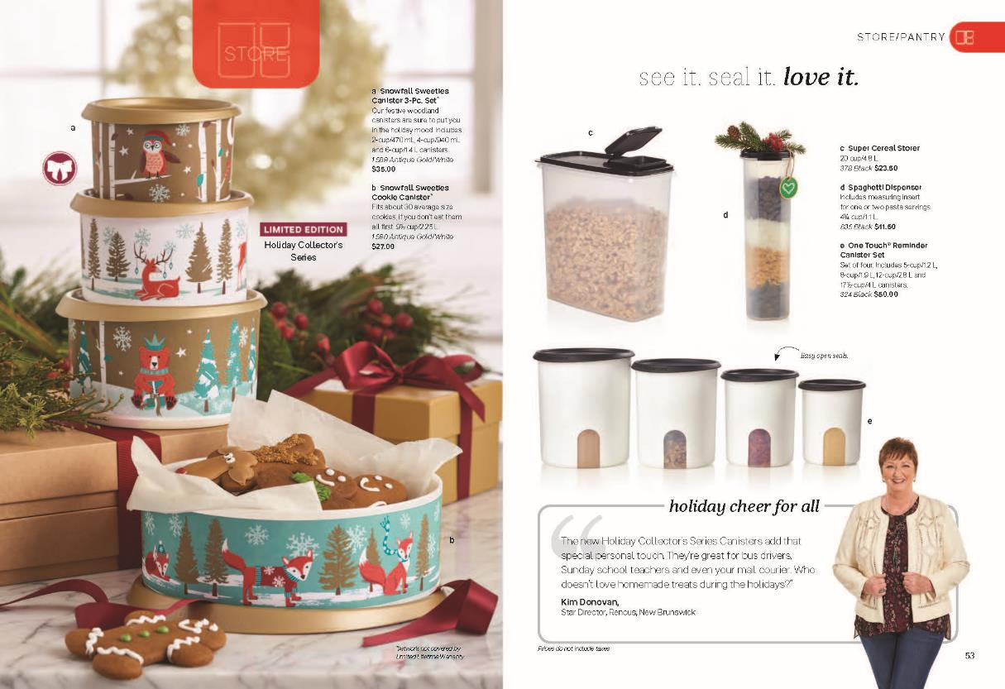
SNOWFALL SWEETIES CANISTERS
Continue with your collection of Limited Edition Holiday Canisters. Remember, time is ticking, they are only around during the Holidays and this print will never be available again.
Featuring a testimonial from our Sales Force!

Slide 25
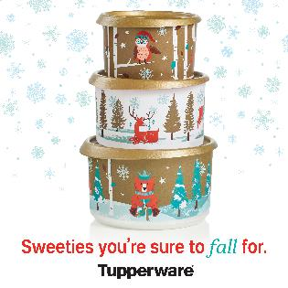
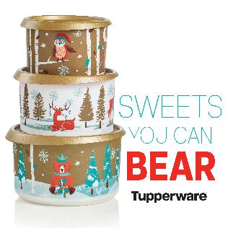
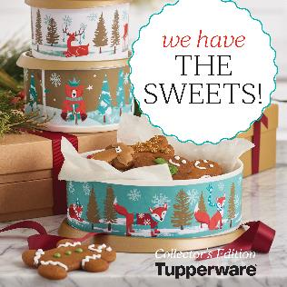
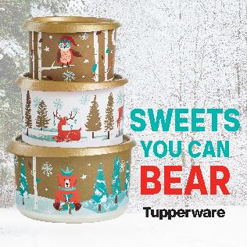
SNOWFALL SWEETIES CANISTERS MEMES

Slide 26
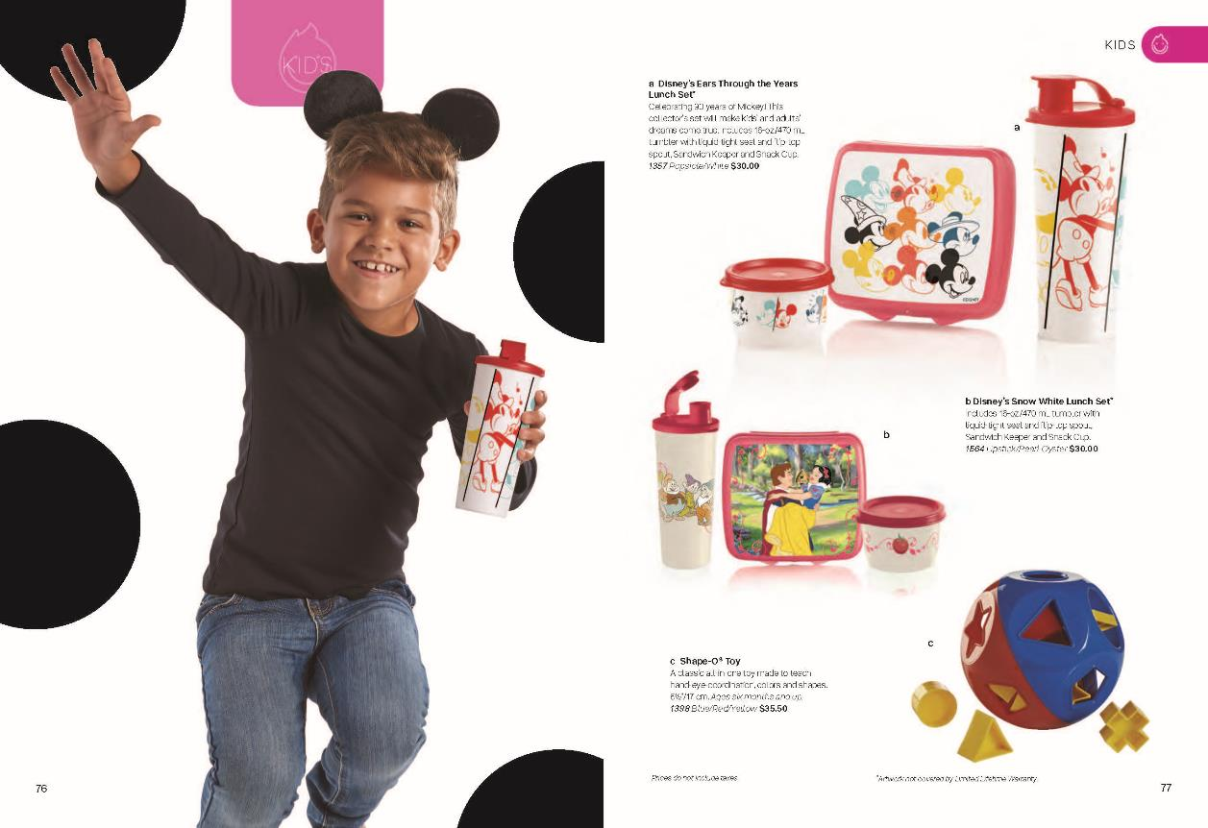
DISNEY EARS THROUGH THE YEARS LUNCH SET
Let’s celebrate 90 years with Mickey Mouse with a Limited Edition, exclusive print Tupperware lunch set.

Slide 27
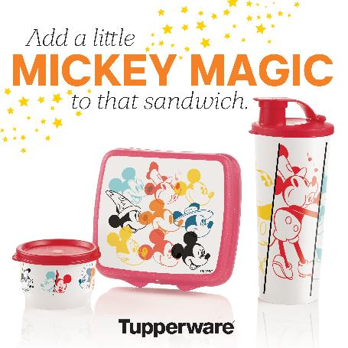
DISNEY EARS THROUGH THE YEARS MEMES

Slide 28
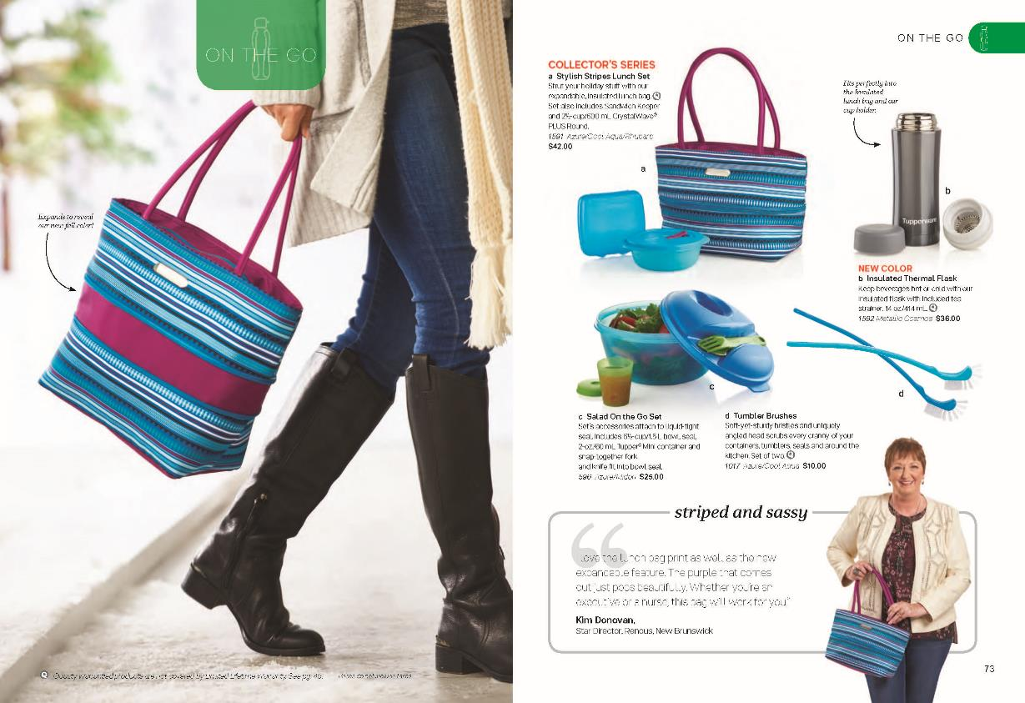
STYLISH STRIPES LUNCH SET
It expands, it’s a Limited Edition Collector’s Series, and it includes the timeless Sandwich Keeper (it can hold so much more) and CrystalWave – your soup and sandwich Tupperware set.
Featuring a testimonial from our Sales Force!

Slide 29
STYLISH STRIPES LUNCH SET MEMES

Slide 30
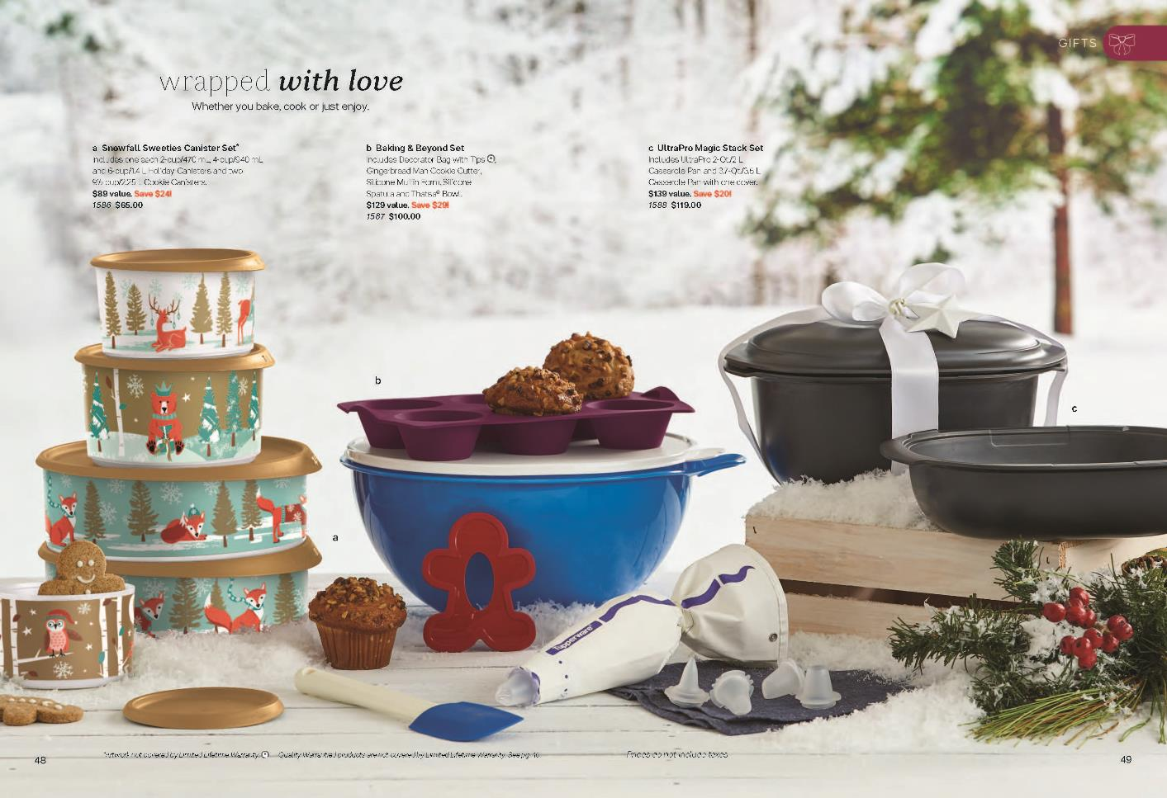
BRING ON THE HOLIDAYS, BRING ON THE GIFTS

Slide 31
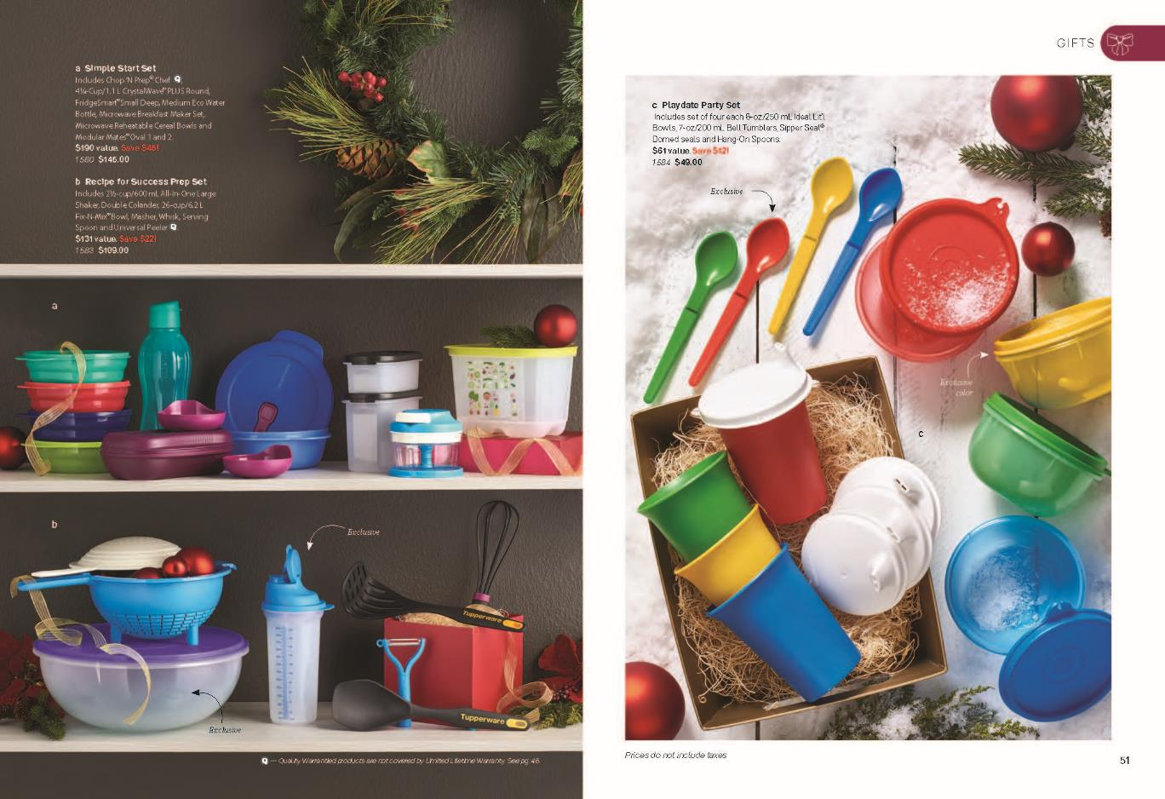
BRING ON THE HOLIDAYS, BRING ON THE GIFTS

Slide 32
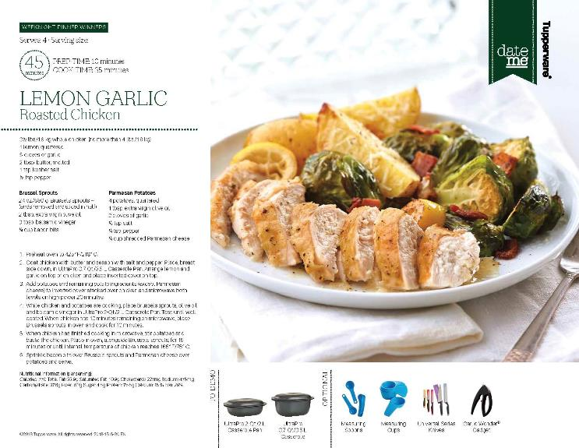
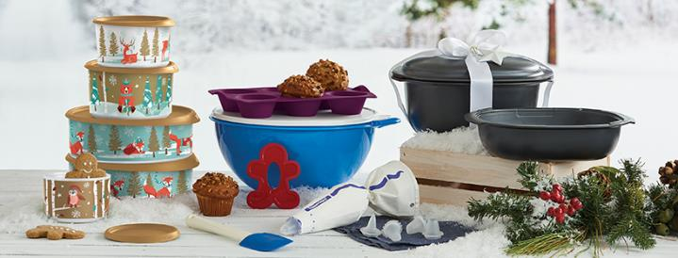
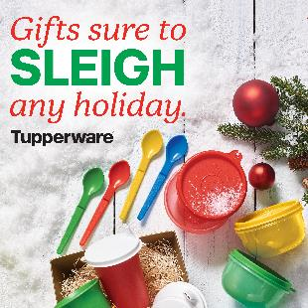
GIFT DATE ME RECIPES, SOCIAL MEDIA COVER, AND MEMES

Slide 33
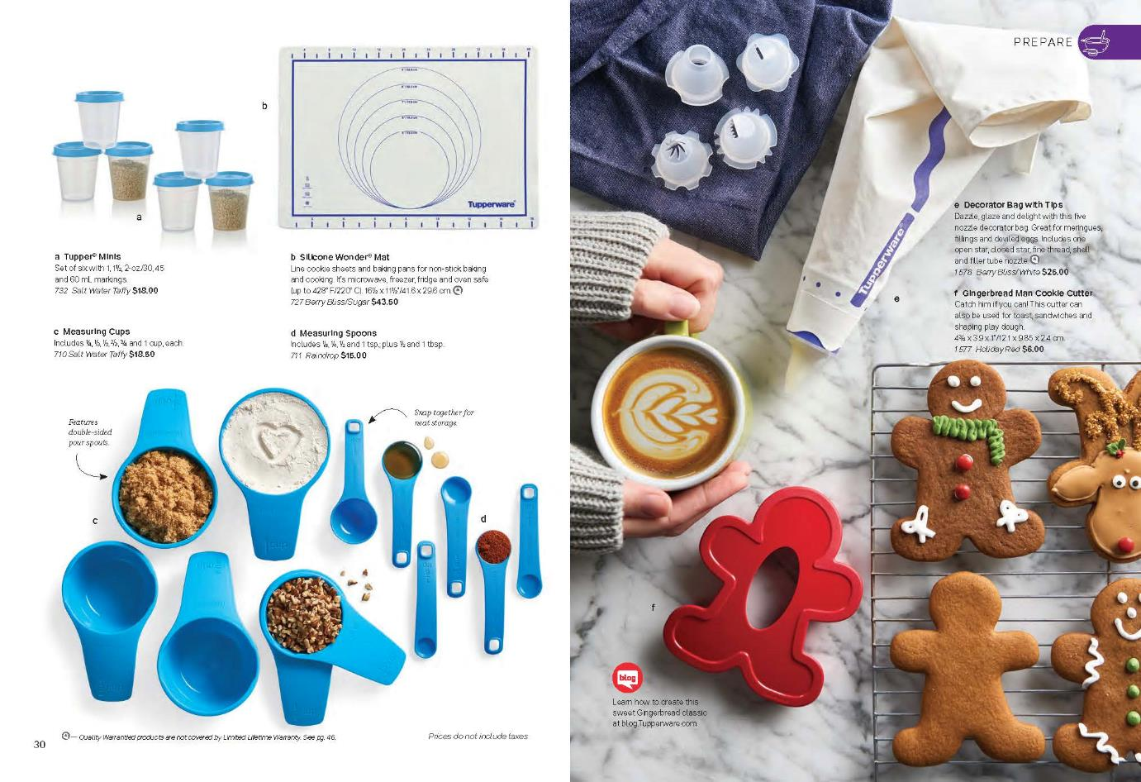
CUT, DECORATE, AND FILL THIS HOLIDAY SEASON

Slide 34
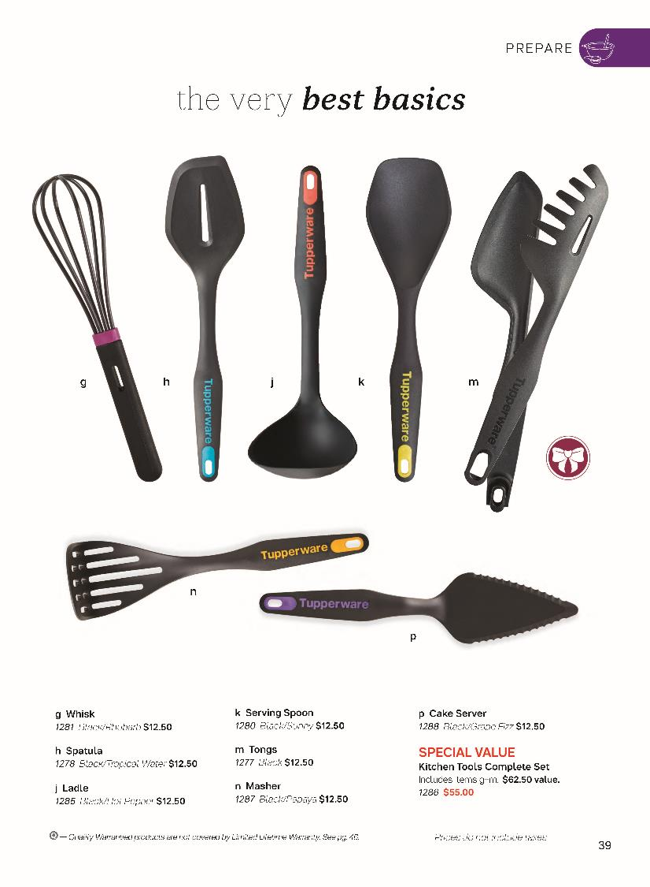
SEASONAL NECESSITIES
Easily cut and serve the perfect cake, casserole, or pie this holiday season with the Cake Server.
Mash your potatoes, root vegetables, even your cauliflower with ease with the Masher. Rounded to mash around the pan. Holes designed to mash without much effort.

Slide 35
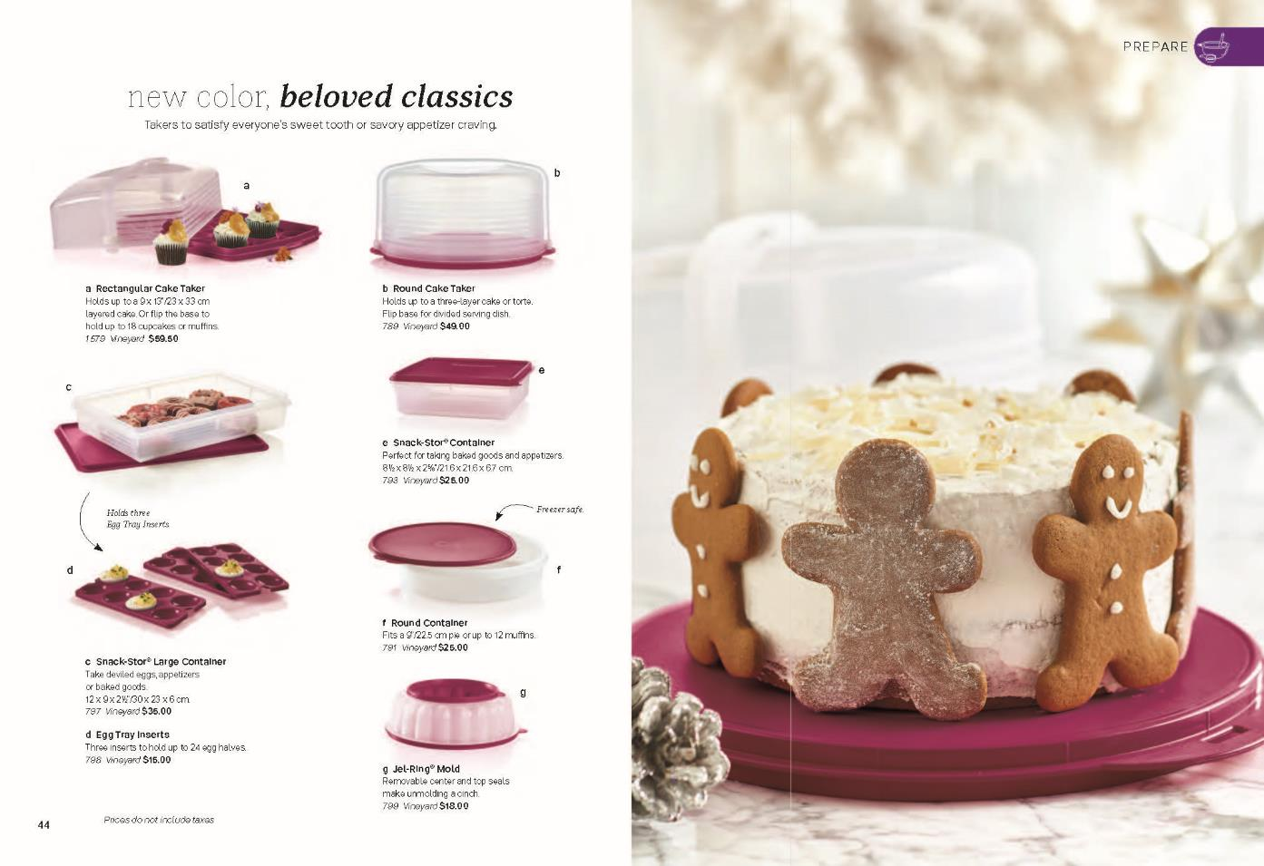
SEASONAL EXCLUSIVES & NEW COLOR CLASSIC TAKERS
SEASONAL EXCLUSIVES

Slide 36
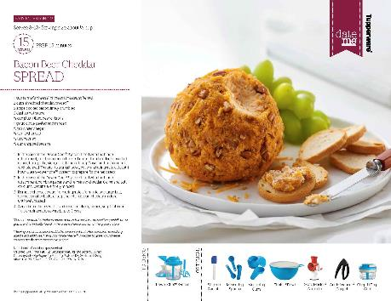
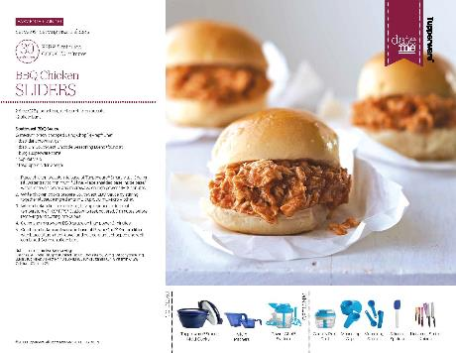
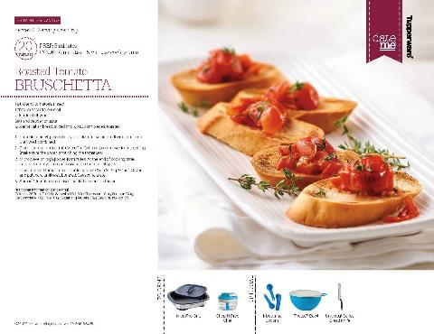
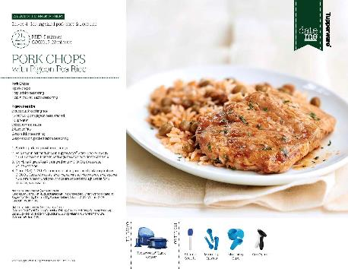
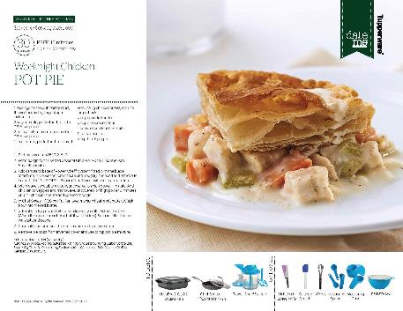
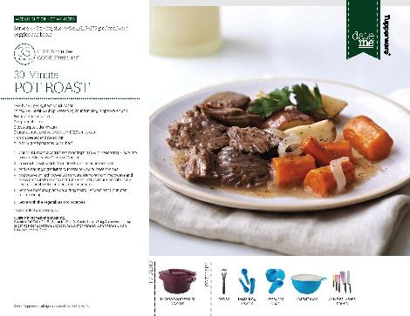
ADDITIONAL DATE ME RECIPE CARDS

Slide 37
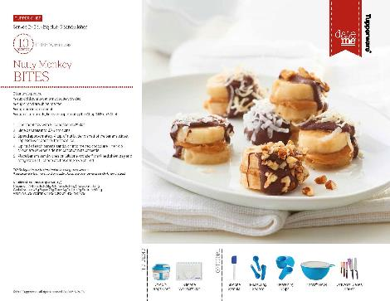
ADDITIONAL DATE ME RECIPE CARDS

Slide 38
ADDITIONAL MEMES

Slide 39
OPPORTUNITY

Slide 41
Confidential – Do Not Share

Slide 42
PRODUCTS NO LONGER AVAILABLE
EXCLUSIVE THANK YOU - SUMMER
TREASURES OF THE SEA WATER BOTTLE
SNACK-STOR LARGE CONTAINER IN MINT ICE CREAM
FISHY FUN SANDWICH CUTTER
HOST SUMMER
TREASURES OF THE SEA PITCHERAND TUMBLERS
RECTANGULAR CAKE TAKE IN MINT ICE CREAM
MERRY MERMAIDS LUNCH SET
FUNDRAISING SUMMER
HAMBURGER KEEPERS
ROUND CONTAINER IN MINT ICE CREAM
PLAYFUL PIRATES LUNCH SET
BOGO SUMMER
HAMBURGER PRESS AND KEEPERS SET
EGG TRAY INSERTS IN MINT ICE CREAM
KIDS BAKING SET
TREASURE OF THE SEA LUNCH SET
CHEF SERIES II 11”/28 CM FRY PAN WITH GLASS COVER
JEL-RING MOLD IN MINT ICE CREAM
LOLLITUPS FREEZABLE FORMS
CHEF SERIES II 9”/24 CM GRIDDLE
JEL-ETTE MOLDS IN MINT ICE CREAM
MANDOLINE CUTTING BOARD

